Slide 1
Real Time RNN Predictor
ME EN 595R – Deep Learning for Engineers
Joshua Spiesman

Slide 2
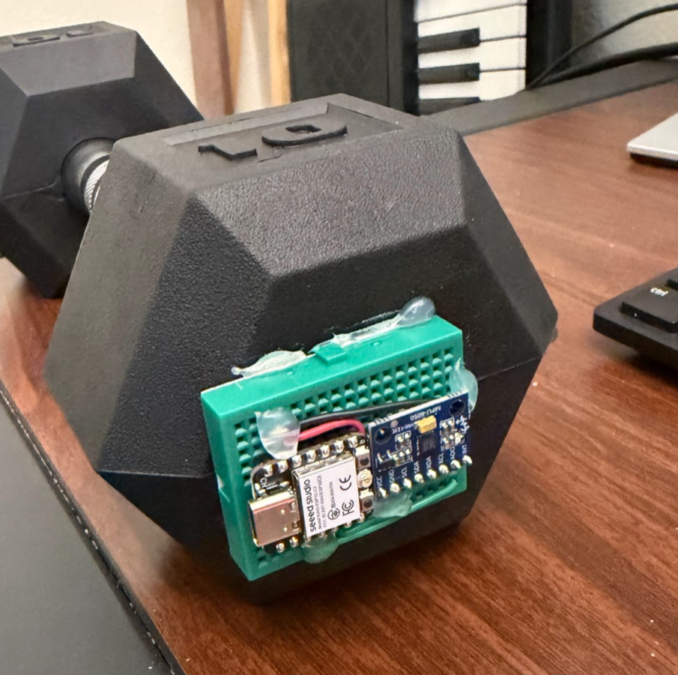
Embedded Rep Counter
An Alarm clock that doesn’t turn off until you work out!
Live sensor data to estimate rep count.

Slide 3
Embedded Rep Counter
Why use machine learning?
Improve Accuracy

Slide 4
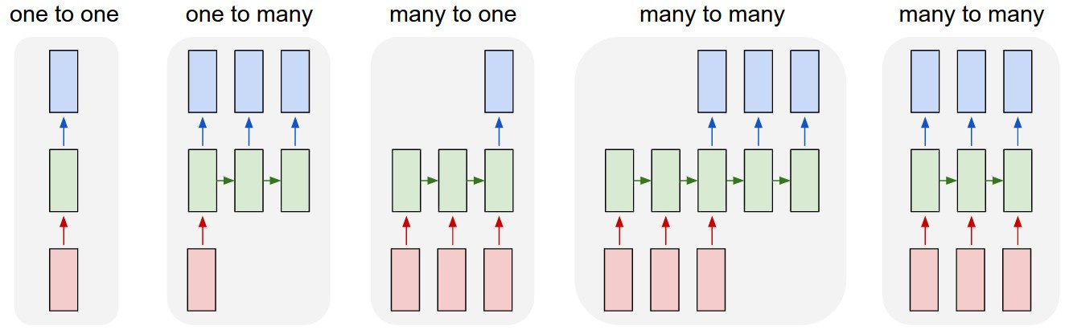

Slide 5
Sliding Window
Avoid Phase Flicker
Labels = 0, 1, 2, or 3 reps
Real time output:
000001111122222211111100000

Slide 6
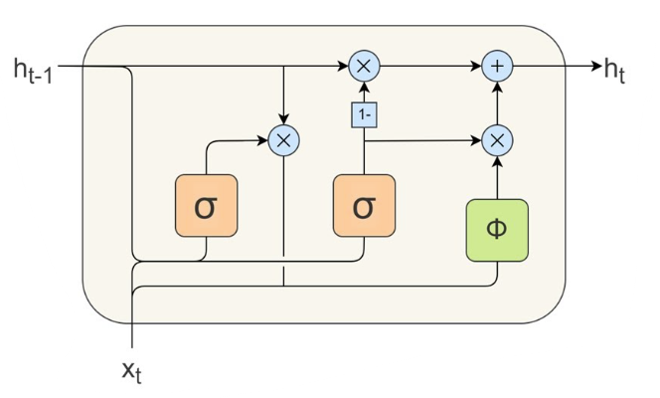

Slide 7
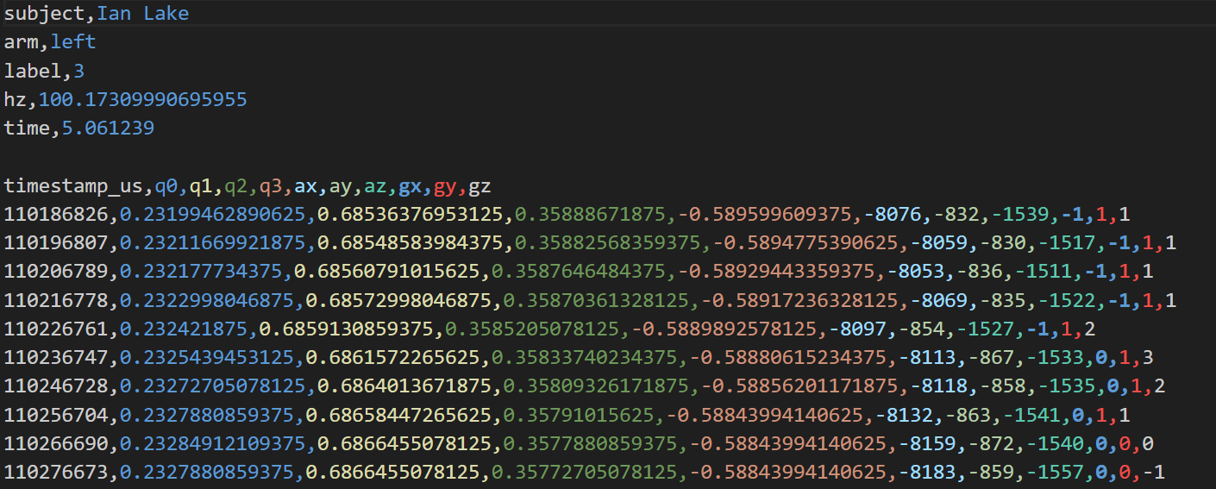

Slide 9
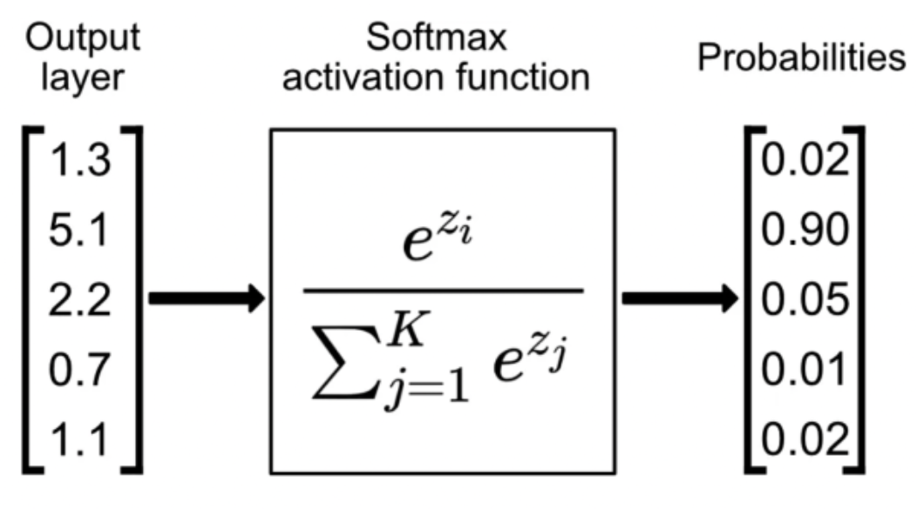

Slide 10
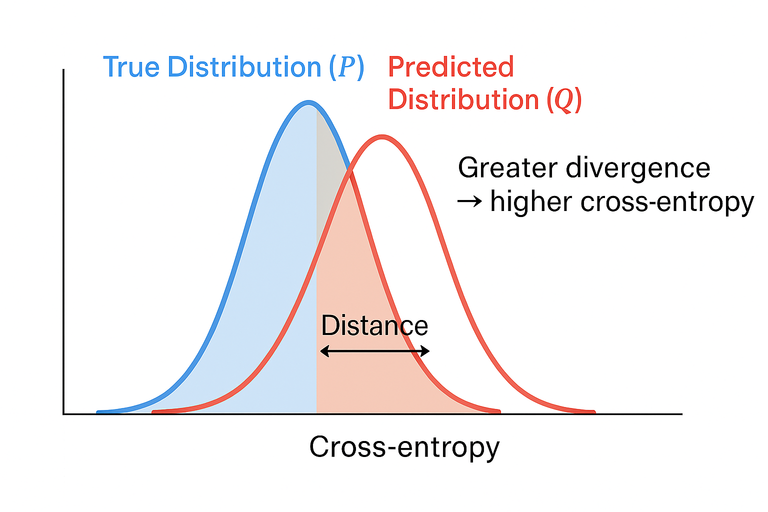

Slide 11
Last Layer
h_t → linear layer → y_t
h_t → MLP (increase depth) → y_t

Slide 12
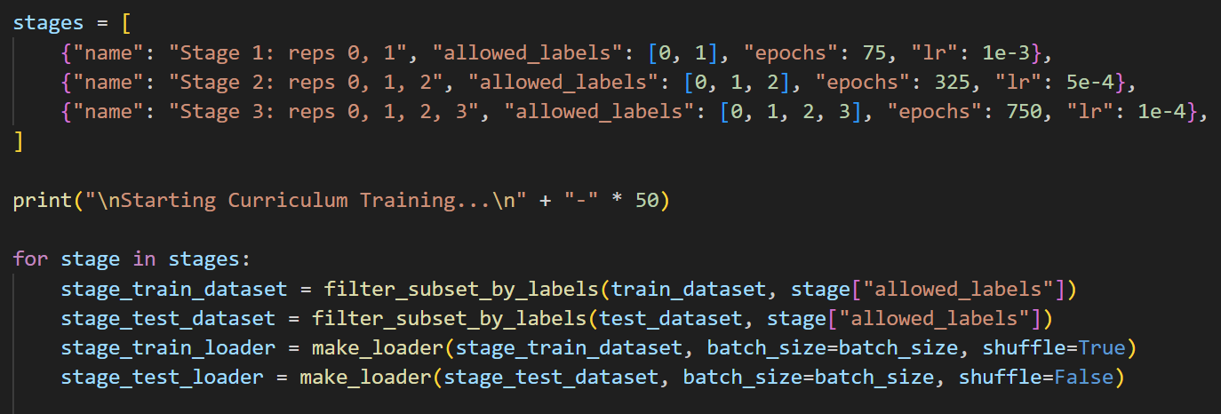
Where I saw the greatest improvements
Curriculum Training Scheme

Slide 13
Improvements and Implementations
More Data (over-fitting too soon)
More Labels, improve balance bias (vs. high accel)
Play with more depth (MLP, resource trade-off)
More complex features
Smaller windows
Flicker trade-off

Slide 14
Improvements and Implementations
Sliding Window
Avoid Phase Flicker
Labels = 0, 1, 2, or 3 reps
Real time output:
000001111122222211111100000

Slide 15
Improvements and Implementations
Sliding window of live sensor data
Pass window through model
Real time output:
000001111122222211111100000
Logic to turn output into rep count

